Slide 1
Before We Start, make sure….
You have taken a recent pull of the app from https://github.com/androidbootcamp/Android-Bootcamp-V1.1 and checkout Day_5 branch.

Slide 2
Agenda
Recap of AsyncTask and Caching
Introduction to Fragments
Convert Product Detail Activity to Fragment
Implement View Pager
Feedback

Slide 3
AsyncTask
Activity
Repo
Get Products
Products Callback
Get Products
Response Callback - onPostExecute
Backend
Request - doInBackground
AsyncTask
Response

Slide 4
Caching

Slide 5
Fragments
What is a Fragment
Why is it needed ?

Slide 6
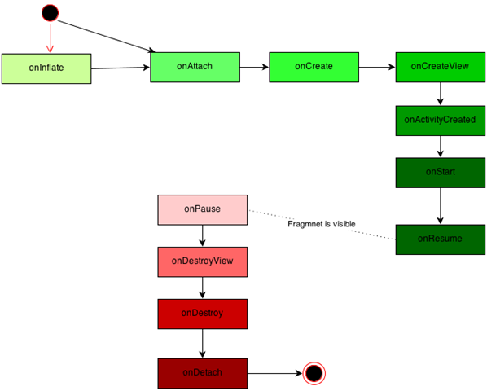
Fragment Lifecycle

Slide 7
Fragments
Converting an Activity to Fragment

Slide 8
Assignment 12
Move View Rendering logic to Fragment
Send parameters to Fragment
Add Fragment to Activity using Fragment Manager

Slide 9
View Pager
Introduction to View Pager
Implementation

Slide 10
Assignment 13
Add View Pager to the Activity Layout
Implement Fragment State Pager Adapter
Assign Pager Adapter to View Pager

Slide 11
Feedback Time

Slide 12
Thank You !

Slide 13
References
http://developer.android.com/guide/components/fragments.html
https://developer.android.com/training/basics/fragments/index.html
http://www.vogella.com/tutorials/AndroidFragments/article.html
http://developer.android.com/training/animation/screen-slide.html
http://android-developers.blogspot.in/2011/08/horizontal-view-swiping-with-viewpager.html

